Slide 1




Science Journalism ~Andrea Blake
Northern Arizona University
Daily Sun Internship
Mentor: Chris Etling
April 19, 2025

Slide 2



Goal:
Find a story related to science
Submit one article per month
Personally I wanted to learn and become a better writer.

Slide 3

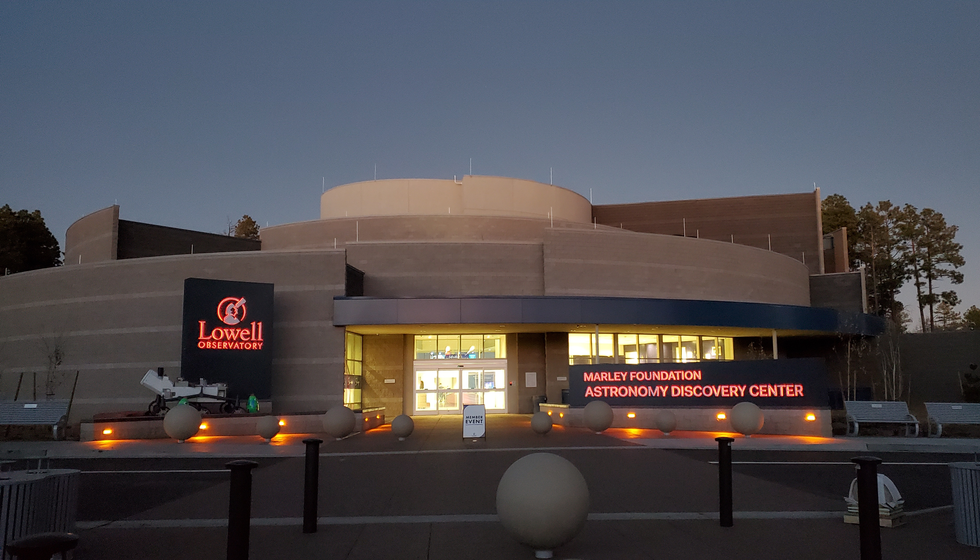

Slide 4
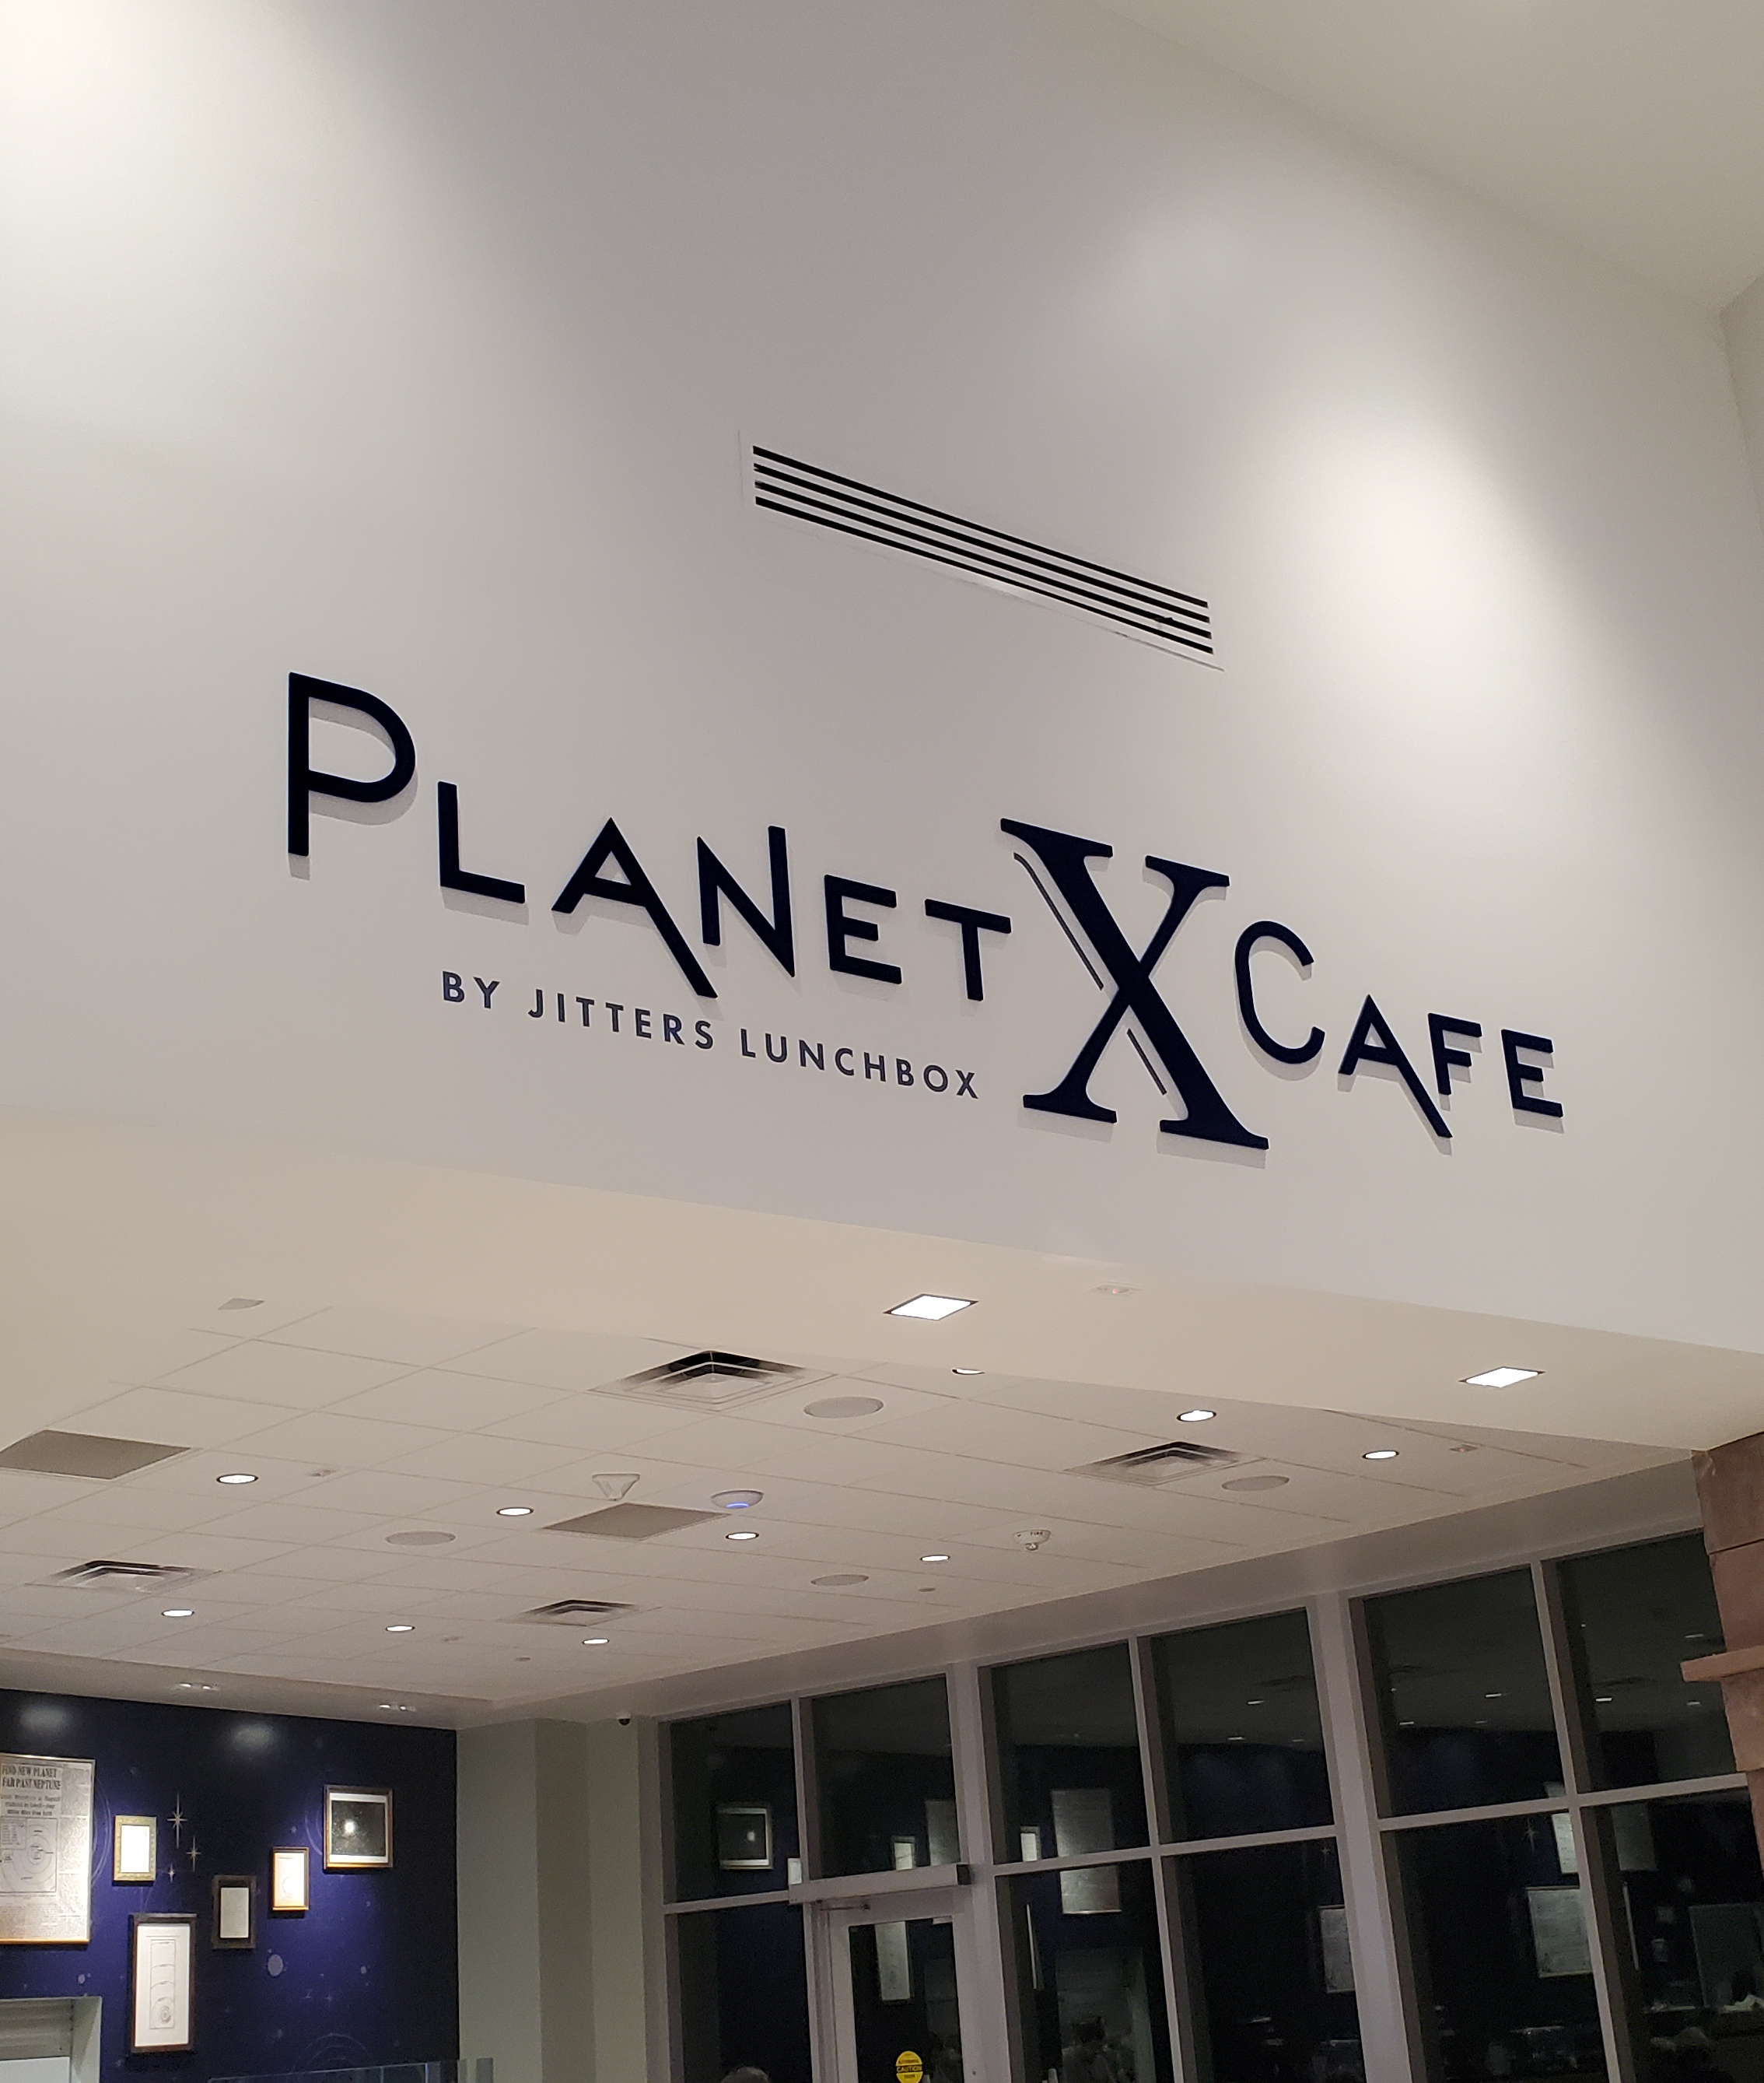
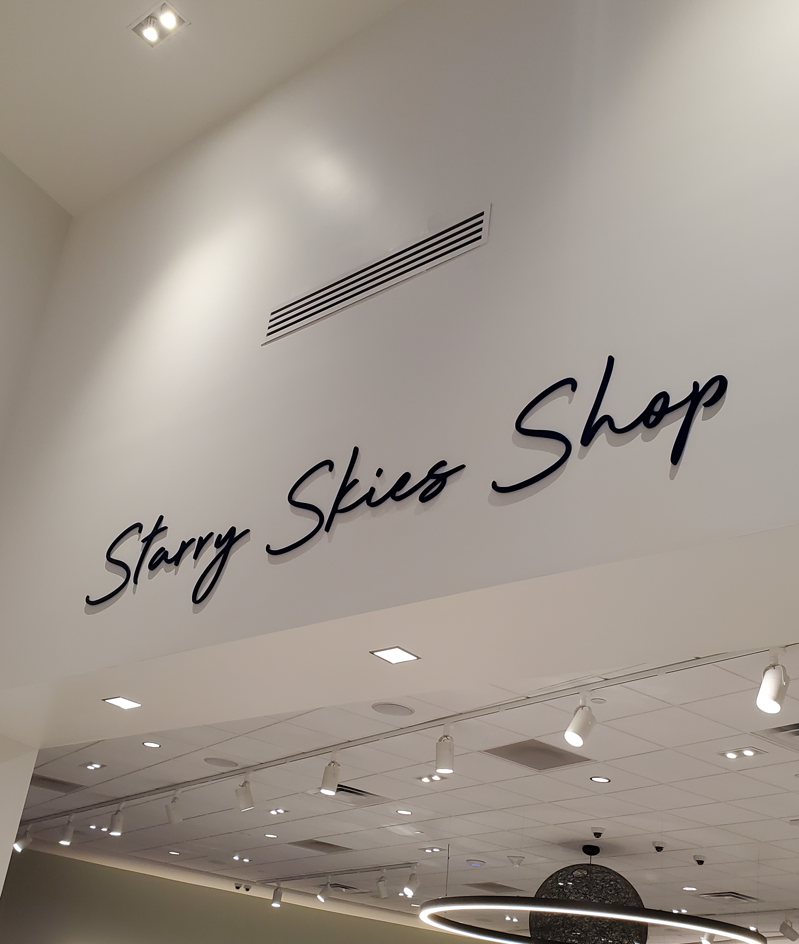


Slide 5
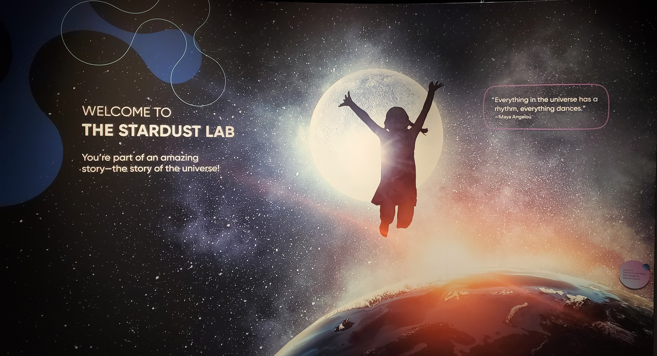


Slide 6
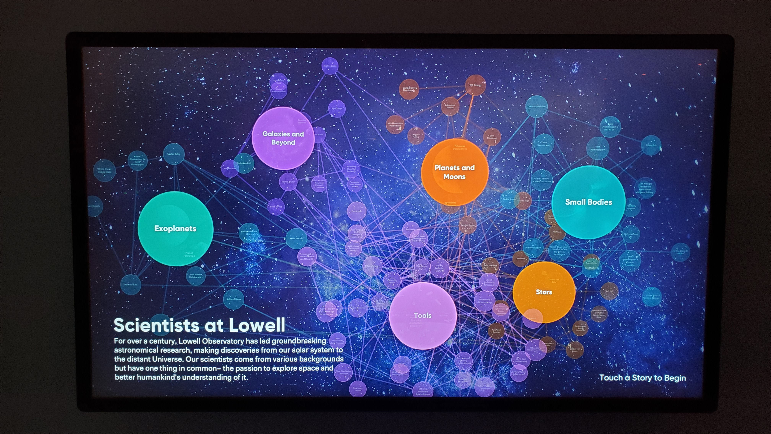

Slide 7
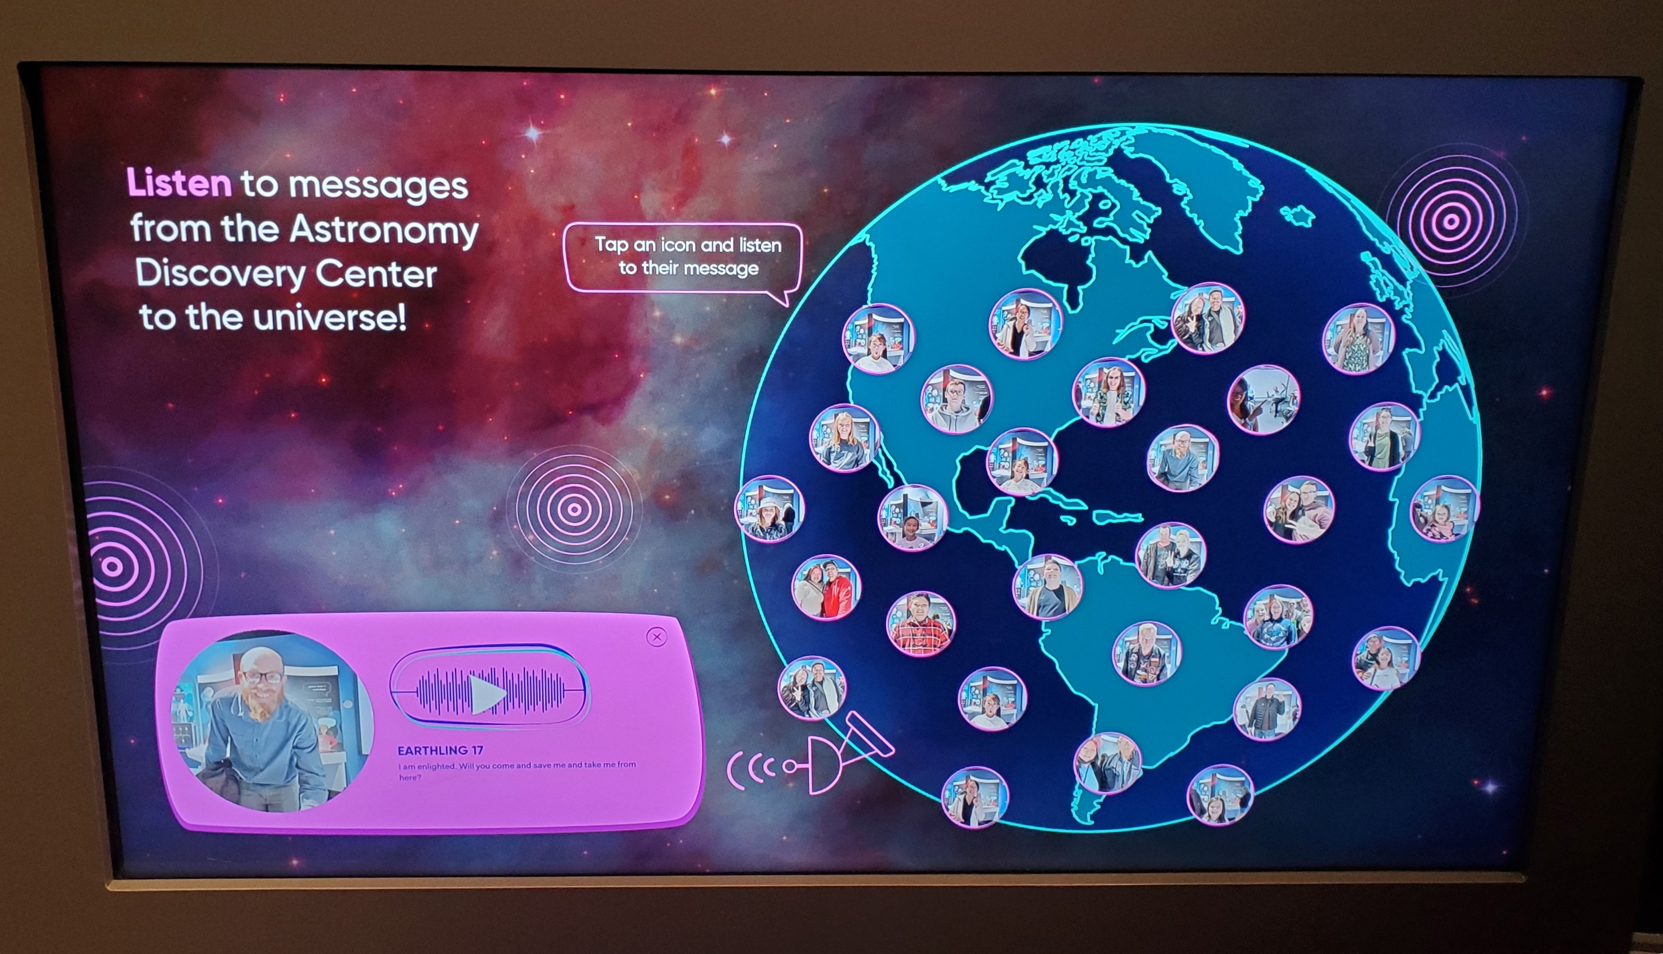

Slide 8
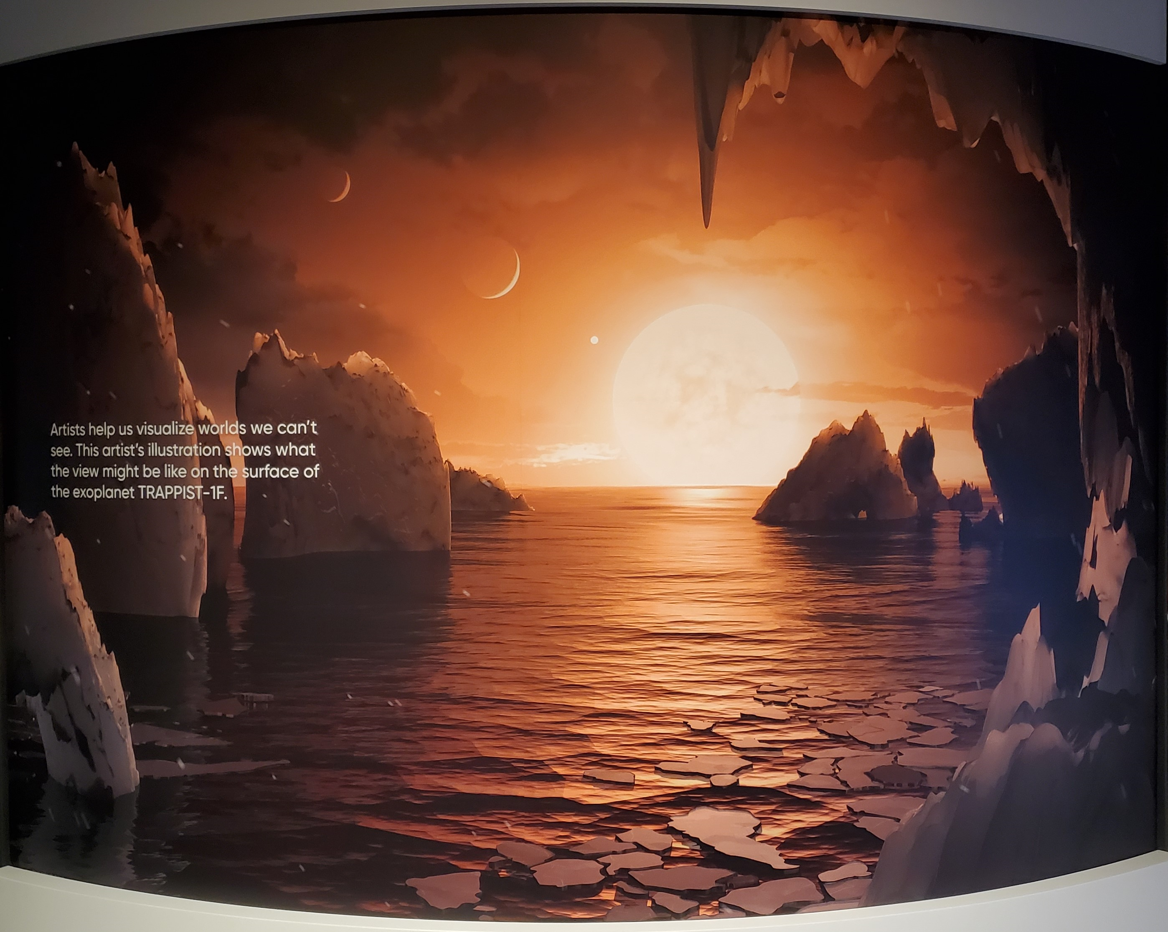

Slide 9
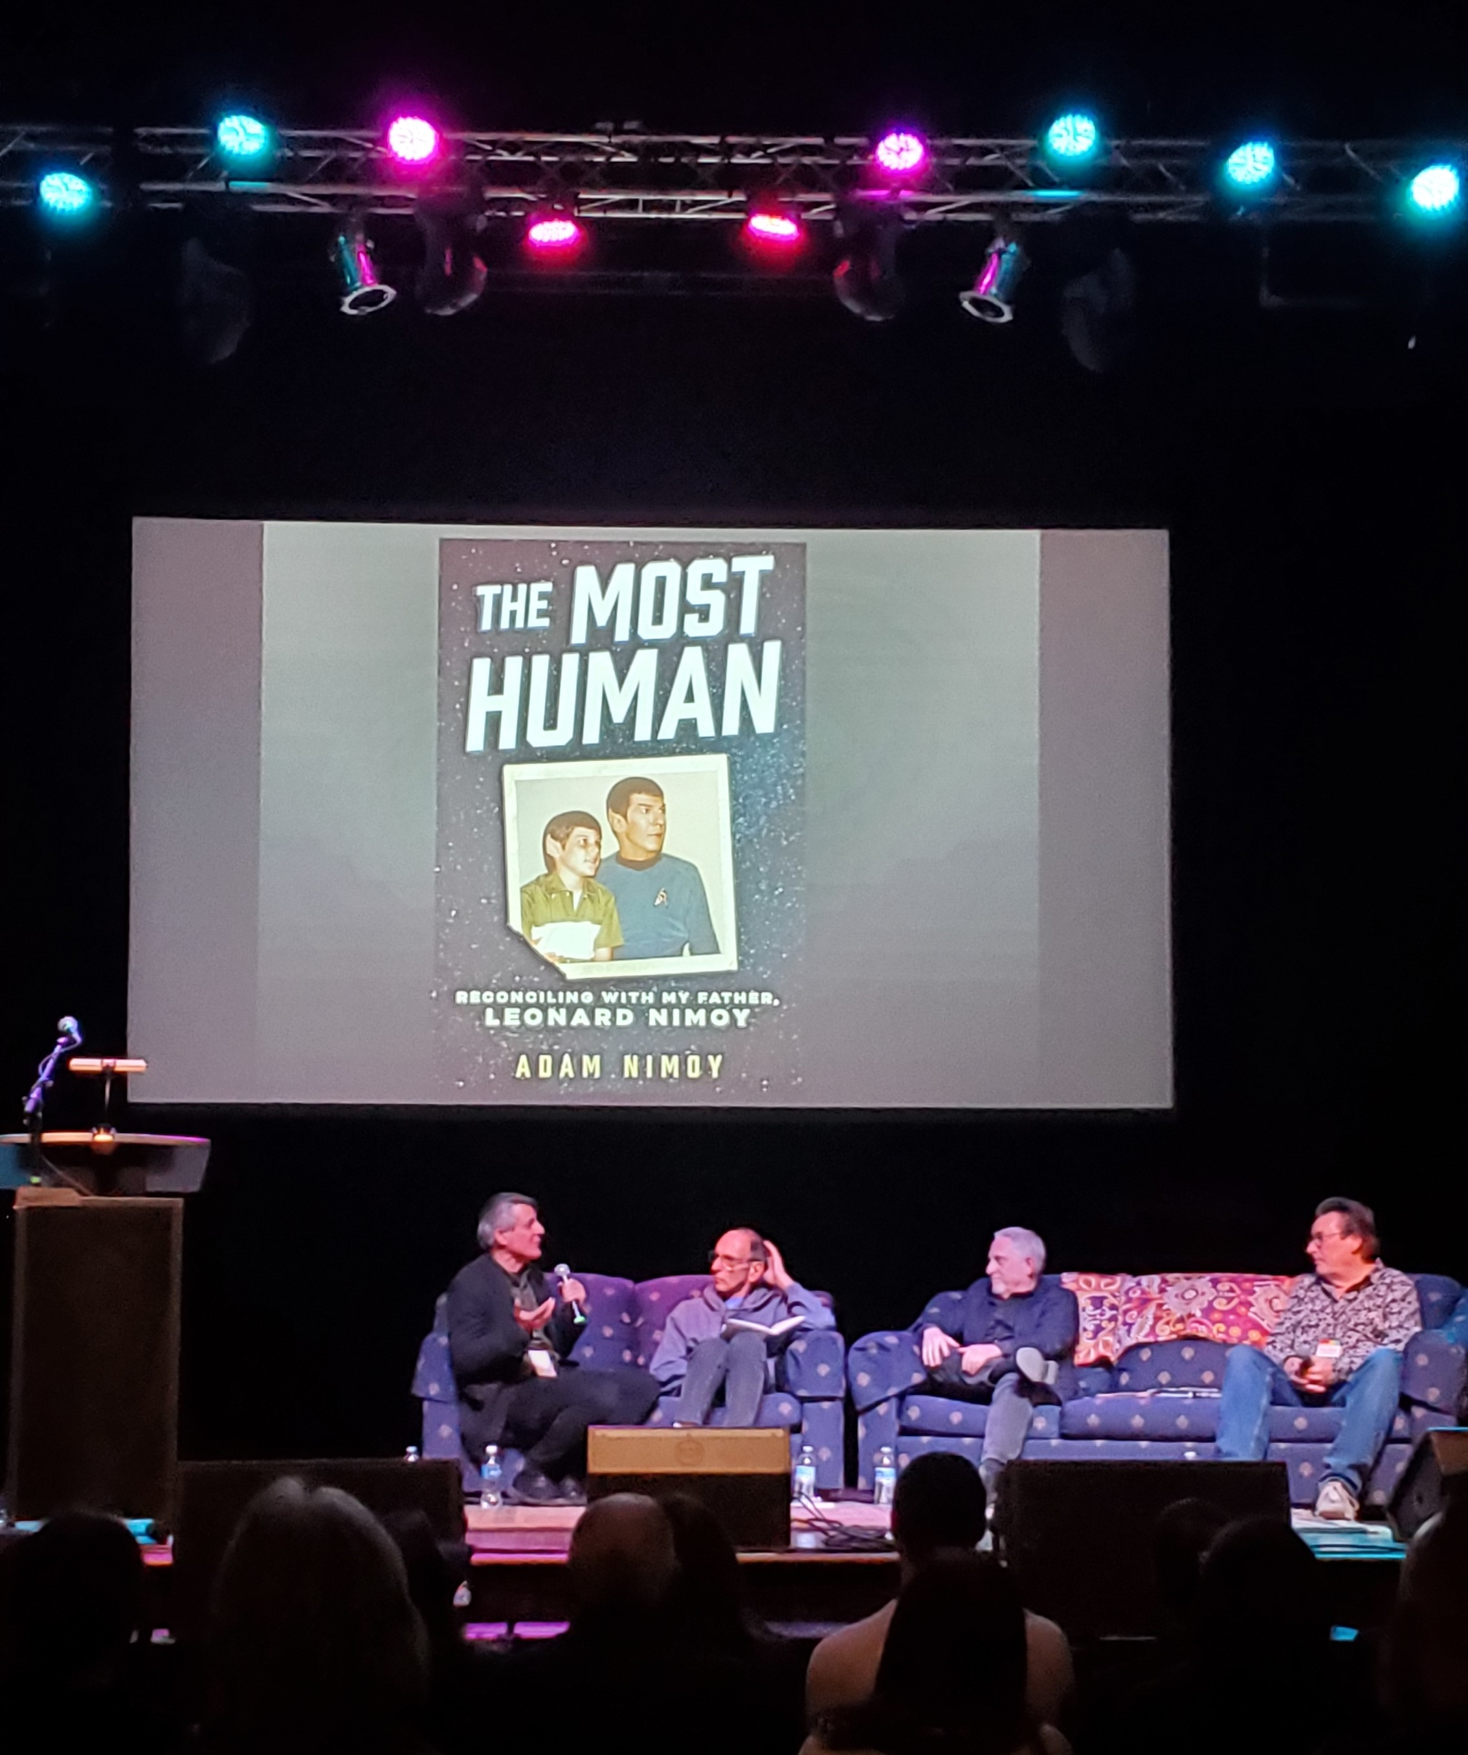


Slide 10
Conclusion
I learned a great deal from this internship and am very thankful for the experience of working for the Daily Sun.

Slide 11
Acknowledgements
NAU/NASA Space Grant Program
Paloma Davidson (Program Assistant Manager)
Chris Etling (Daily Sun Editor)
Kevin Schindler (Lowell Observatory Historian)

Slide 12

Thank You!

